Slide 1
REST Web Services
Apache Maven,
Spring Framework,
Apache CXF,
JAX-RS,
Swagger UI and embedded Jetty Server
BALAKUMAR SETHURAMAN

Slide 2
REST Web Services
Objectives
Introduction to REST
RESTful Principles
HTTP Protocol
HTTP Request Message
HTTP Response Message
HTTP-REST Vocabulary
Securing Services
HTTP Status Codes
JAX-RS vs Spring MVC
REST Services with JAX-RS
REST Services with Spring MVC
Swagger
Swagger UI - Frontend for REST Service
JAX-RS with Swagger Annotations
Code on GIT
Conclusion
Q&A

Slide 3
Objectives
At the end of this presentation, the participant will be able to :
Understand the basics of REST
Understand the basics of the HTTP protocol
Understand a REST API implementation
Understand how the JAX-RS APIs and annotations can be used to develop REST web services.
Understand how JAX-RS differs and compares to Spring MVC
Understand a RESTful Service using Swagger UI

Slide 4
Introduction to REST
The REST stands for Representational State Transfer.
Representational
- Representational means formats (such as xml, json, yaml, html, etc)
- Clients possess the information necessary to identify, modify, and/or delete a web resource.
State
- State means data
- All resource state information is stored on the client.
Transfers
- Transfer means carry data between consumer and provider using HTTP protocol
- Client state is passed from the client to the service through HTTP.
The author of the REST (It is also called as RESTful Web Services) is Roy Fielding.

Slide 5
RESTful Principles
The following principles encourage RESTful applications to be simple, lightweight, and fast:
Uniform interface:
This is the API of the web service, describing operations and data structures.
Resources are manipulated using the following operations(HTTP Methods): PUT, GET, POST, and DELETE.
Resource identification through URI:
Resources are identified by URIs, which provide a global addressing space for resource and service discovery. for example, The @Path Annotation
Self-descriptive messages:
Resources are decoupled from their data representation. Diff formats, such as HTML, XML, plain text, PDF, JPEG, JSON, and others.
Stateless
No client context should be store on the server between requests.
Each request contains all of the information necessary to service the request and session state is held in the client.
The server can be stateful, but server-side state must be addressable by URL as a resource.
This makes servers:
More scalable.
More visible for monitoring.
More reliable in the event of partial network failures

Slide 6
HTTP Protocol
The http protocol have:
1) Http request message (Prepared by consumer)
2) Http response message (Prepared by provider)

Slide 7

Http Request Message
It is the responsibility of consumer means client application to prepare and send http request message as given below:
POST /SpringREST/customers HTTP/1.1
Accept: application/xml
Content-Type: application/xml
Content-Length: 196
User-Agent: Java/1.7.0_25
Host: 127.0.0.1:7000
Connection: keep-alive

Slide 8
Http Request Message
The Http request message always starts with one of the http method name such as GET, POST, PUT, DELETE, HEAD, etc
It is the responsibility of consumer to prepare and send http request message with appropriate http method name depending on operation:
-The GET method is used to perform READ operation.
-The POST method is used to perform INSERT operation.
-The PUT method is used to perform UPDATE operation.
-The DELETE method is used to perform DELETE operation.
The payload means body in http request message is optional and depends on http method name i.e.,
-In case of GET method, the http request message without body
-In case of POST method, the http request message with body
The 'Content-Type' header name in http request message is used to represent payload format in http request message.
The 'Accept' header name in http request message is used to represent expected payload format in http response message.

Slide 9

HTTP Response Message
It is the responsibility of business component (developed by service provider) to prepare and send http response message as given below:
HTTP/1.1 200 OK
Content-Type: application/xml
Server: Apache-Coyote/1.1
Transfer-Encoding: chunked
Date: Mon, 10 Nov 2014 09:45:34 GMT

Slide 10
HTTP Response Message
The payload means body in http response message is optional and depends on http status code i.e.,
-In case of 204 status code, the http response message without body
-In case of 200 status code, the http response message with body
The 'Content-Type' header name in http response message is used to represent payload format in http response message.
Conclusion:
1) Both http request header and http response header contains 'Content-Type' to represent payload formats.
2) Only http request header additionally contains 'Accept' to represent expected payload format in http response message.
3) The 'Accept' in request header and 'Content-Type' in response header must be same then only client will accept and process http response message.

Slide 11
HTTP-REST Vocabulary
HTTP Methods supported by REST:
GET – Requests a resource at the request URL
Should not contain a request body, as it will be discarded.
May be cached locally or on the server.
May produce a resource, but should not modify on it.
POST – Submits information to the service for processing
Should typically return the new or modified resource.
PUT – Add a new resource at the request URL
DELETE – Removes the resource at the request URL
OPTIONS – Indicates which methods are supported
HEAD – Returns meta information about the request URL

Slide 12
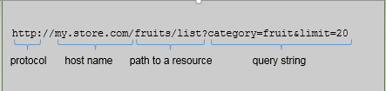
HTTP-REST Vocabulary
A typical HTTP REST URL:
The protocol identifies the transport scheme that will be used to process and respond to the request.
The host name identifies the server address of the resource.
The path and query string can be used to identify and customize the accessed resource.

Slide 13
Securing Services
Authentication is the act of verifying that a given request is from someone (or some system) that is known to the service and that the requestor is who they say they are. While authentication is the act of verifying a requestor is who they say they are, authorization is verifying the requestor has permission to perform the requested operation.
Essentially, the process goes something like this:
Client makes a request, including authentication token in X-Authorization header or token query-string parameter in the request.
Service verifies presence of the authorization token, validates it (that it's valid and not expired) and parses or loads the authentication principal based on the token contents.
Service makes a call to the authorization service providing authentication principal, requested resource and required permission for operation.
If authorized, service continues with normal processing.
#3 above could be expensive, but assuming a cacheable access-control list (ACL), it is conceivable to create a authorization client that caches the most-recent ACLs to validate locally before making remote calls.

Slide 14
HTTP Status Codes
The Http response message contains any one of the http status code ranges between 100 and 599:
Informational : 1xx
Successfull : 2xx
Redirectional : 3xx
Client side error : 4xx
Server side error : 5xx
Sample HTTP Status Codes:
200 (OK) – General success status code.
201 (CREATED) – Successful creation occurred (via either POST or PUT). Response body content may or may not be present.
400 (BAD REQUEST) – Request with invalid state (Ex. missing data) etc.
401 (UNAUTHORIZED) – Error code missing or invalid authentication token.
404 (NOT FOUND) – Used when the requested resource is not found
500 (INTERNAL SERVER ERROR) – The general catch-all error when the server-side throws an exception.

Slide 15
REST on the Java Stack
Although developers may implement REST web services however they choose, the Java Stack team is best equipped to support the following:
Apache CXF
A JAX-RS web service framework
Spring MVC
An MVC framework built upon the Spring Platform (does not implement the JAX-RS specification)

Slide 16

CXF Web Services Framework
Apache CXF is a robust framework designed specifically for producing and consuming web services:
It is open-source and free to use.
It supports several web service standards and JSR APIs.
It provides tooling and configuration for JAX-WS and JAX-RS services.
It provides integration with the Spring Application Framework, the core technology upon which most of the Java Stack is built.

Slide 17
REST Services with JAX-RS
JAX-RS is a Java standard API for REST services:
Services are annotation driven
Provides support for data binding.
Provides advanced APIs for content negotiation.
CXF provides an implementation of JAX-RS:
Supports CXF filters, interceptors, and invokers to customize and extend the service.
Configurable through Spring.
Integrates with security providers.

Slide 18
JAX-RS Annotations
JAX-RS is a Java standard API for REST services:
@Path - The @Path annotation’s value is a relative URI path indicating where the Java class will be hosted.
@GET - The @GET annotation is a request method which will process HTTP GET requests.
@POST - The @POST annotation is a request method which will process HTTP POST requests.
@PUT - The @PUT annotation is a request method which will process HTTP PUT requests.
@DELETE - The @DELETE annotation is a request method which will process HTTP DELETE requests.
@PathParam - The @PathParam annotation is a type of parameter that you can extract for use in your resource class.URI path parameters are extracted from the request URI.
@QueryParam - The @QueryParam annotation is a type of parameter that you can extract for use in your resource class. Query parameters are extracted from the request URI query parameters.
@Consumes - The @Consumes annotation is used to specify the MIME media types of representations a resource can consume that were sent by the client.
@Produces - The @Produces annotation is used to specify the MIME media types of representations a resource can produce and send back to the client.

Slide 19
REST Services with Spring MVC
Spring MVC is a model-view-controller framework built upon the Spring Application Framework.
Annotation driven
Supports a RESTful pattern of routing requests to web resources using HTTP vocabulary.
Not an implementation of the JAX-RS specification.

Slide 20
JAX-RS or Spring MVC?
Some Guidelines for choosing your solution:
Both JAX-RS and Spring MVC can produce REST services.
Spring MVC is a web application framework that can be used as service framework.
Provides better validation
Supports internationalization
JAX-RS is a primarily a services framework.
Provides support for WADL generation
Can use CXF interceptors, filters, etc.

Slide 21
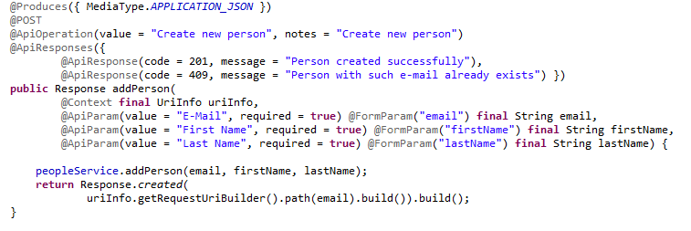
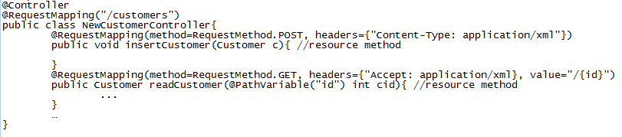
JAX-RS VS Spring MVC
Comparison between JAX-RS API annotations and SPRING with REST API annotations:
JAX-RS SPRING with REST
@Path @RequestMapping
@POST RequestMethod.POST
@GET RequestMethod.GET
@Consumes("application/xml") Content-Type=application/xml
@Produces("application/xml") Accept=application/xml
@PathParam @PathVariable
@RequestBody
@ResponseBody

Slide 22
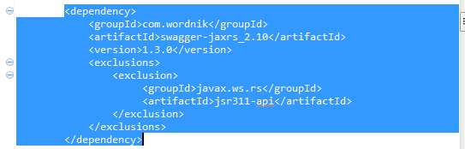
Intro to Swagger
Swagger is the documentation framework for REST APIs
Swagger has built-in support for JAX-RS
The Swagger project allows you to describe, produce, visualize and consume your OWN RESTful services. No proxy or 3rd party services required. Do it your own way.
Swagger UI is a dependency, free collection of HTML, Javascript, and CSS assets that dynamically generate the documentation.
Include Maven dependency to you project:

Slide 23
Swagger-Core Annotations
@Api - The @Api is used to declare a Swagger resource API.
@ApiImplicitParam - Represents a single parameter in an API Operation.
@ApiImplicitParams - A wrapper to allow a list of multiple ApiImplicitParam objects.
@ApiModel - Provides additional information about Swagger models.
@ApiModelProperty - Adds and manipulates data of a model property.
@ApiOperation - Describes an operation or typically a HTTP method against a specific path.
@ApiParam - Adds additional meta-data for operation parameters.
@ApiResponse - Describes a possible response of an operation.
@ApiResponses - A wrapper to allow a list of multiple ApiResponse objects.
@Authorization - Declares an authorization scheme to be used on a resource or an operation.
@AuthorizationScope - Describes an OAuth2 authorization scope.

Slide 24
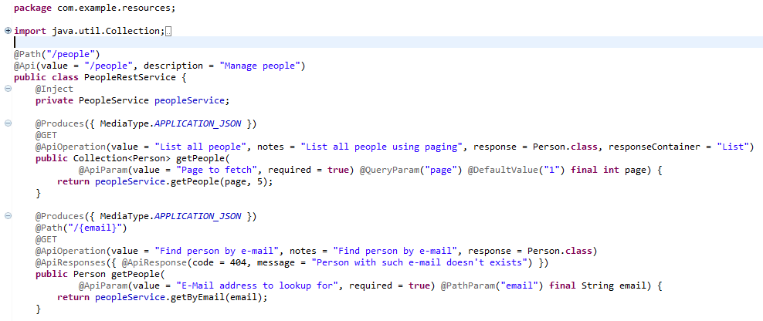
REST API Example

Slide 25
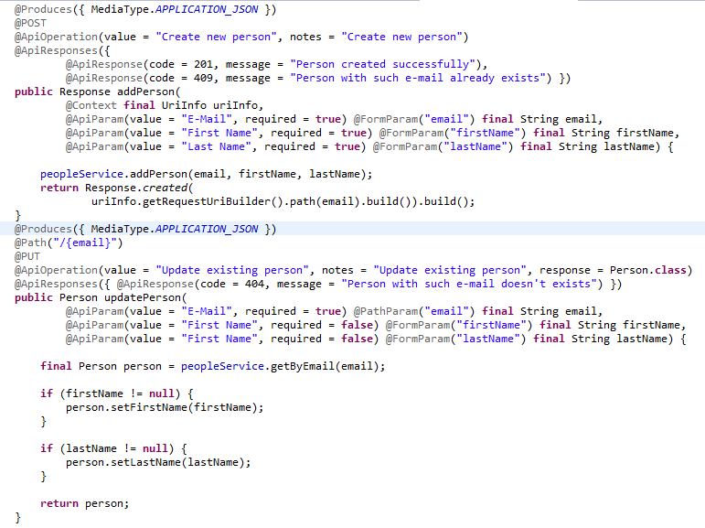
REST API Example

Slide 26
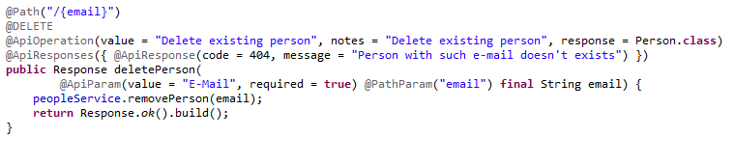
REST API Example

Slide 27
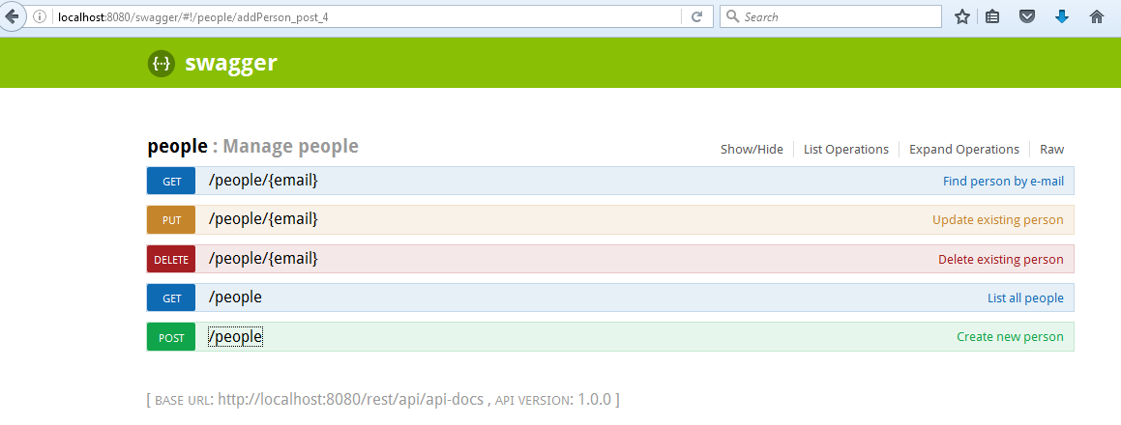
REST API Swagger

Slide 28
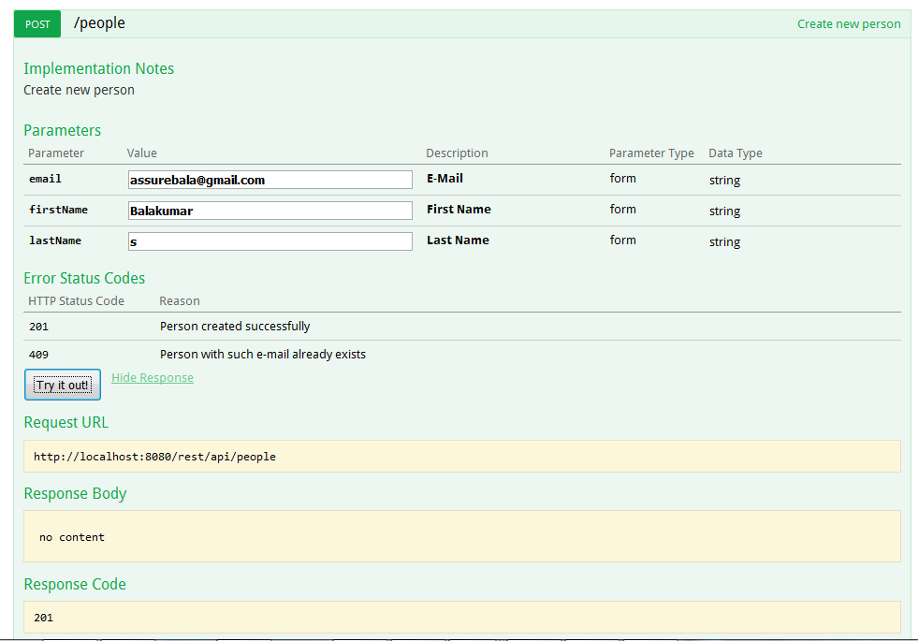

Slide 29
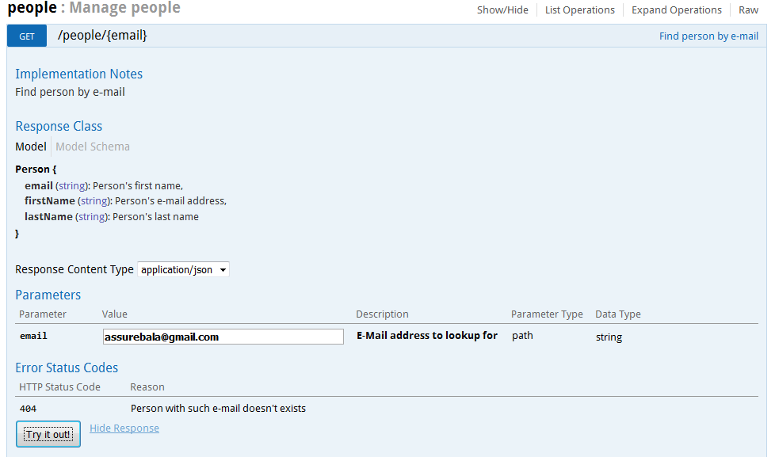
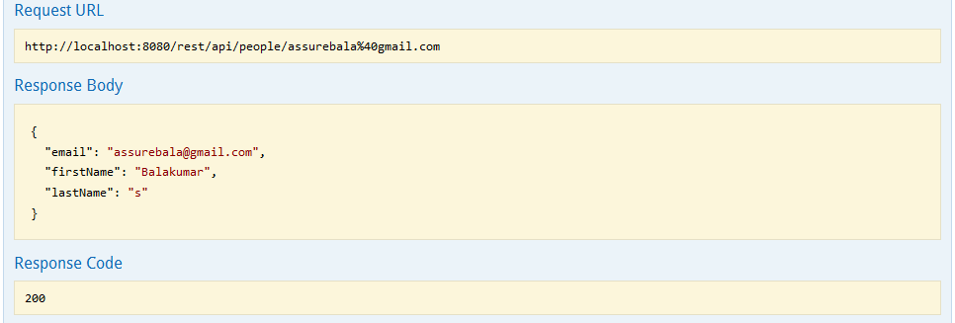

Slide 30
Conclusion
JAX-RS is a flexible API for providing scalable web services.
Swagger UI, Spring and the Java Stack integrate to make developing and configuring REST services easy.

Slide 31
Credit
Resources used to prepare this training:
http://cxf.apache.org
http://en.wikipedia.org/wiki/Representational_state_transfer

